Slide 1
Mobile Apps Development case sharing
Participating in
Web Accessibility Recognition Scheme 2014

Slide 2
Background
So-Biz Project (無障消費計劃)
Organiser – Hong Kong Council of Social Service
Funded by “SME Development Fund” of the Trade and Industry Department of Hong Kong Government
April 2011 to April 2013
To promote “barrier-free” customer service and an inclusive society

Slide 3
So Biz Mobile Apps
Searching for So-Biz restaurants and shops
So-Biz restaurants and shops:
friendly to the elderly, people with disabilities and ethnic minorities

Slide 4
So Biz Mobile Apps
Search by dishes, commodities, districts, and/or types of friendliness

Slide 5
So Biz Mobile Apps
Browse the restaurants and shops’ details (e.g. address, telephone, opening hours, menus/catalog or special offers)

Slide 6
So Biz Mobile Apps
Browse the So-Biz checklist items that they can fulfill
Find their locations in map view

Slide 7
So Biz Mobile Apps
Search for nearby restaurants and shops
“Press to dial” your favourite restaurants and shops

Slide 8
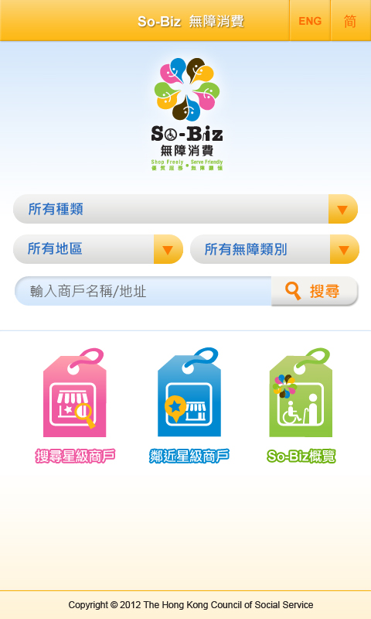
Background – So Biz Apps
Apps development outsourced to Palmary Solutions
Apps developed (both Android & iOS platforms) already launched before the new round of Web Accessibility Recognition Scheme (2014)

Slide 9
Background – So Biz Apps
Web Accessibility Recognition Scheme (2014) was open for application
The first time with Mobile Application Stream provided in Web Accessibility Recognition Scheme
So Biz Mobile Apps applied
Gap between the judging criteria and our existing level. Could we bridge the gap?

Slide 10
Challenge – need to learn
Accessibility – new area of mobile application design and development with a lack of clear picture and resources to follow / adopt
Platform dependence on mobile accessibility
mobile app development technology

Slide 11
Challenge – testing the mobile accessibility
Different platform (Android / iOS) has its own accessibility module (e.g. Talkback, VoiceOver)
Even same platform has different accessibility features in different versions!

Slide 12
perhaps the biggest Challenge
when we found that existing User Interface (UI) & Programming Modules were not compatible with one of the versions of Android platform in mobile accessibility
and only a little time left!

Slide 13
Challenge
Original version
Revised version

Slide 14
Challenge
Original version
Revised version

Slide 15
Challenge
Original version
Revised version

Slide 16
Challenge
Original version
Revised version

Slide 17
What we’ve learnt
Join the accessibility-related briefing and workshops
Not only developer, but also the designer should have knowledge of mobile accessibility
Carefully select what development tools to use, to ensure “accessibility friendly”
Different OS version of mobile devices for accessibility testing is needed
Remember to seek help from your OGCIO’s counterparts. They are very helpful!

Slide 18
What we need to keep learning
Support your vendor in particular when something urgent happened
If it is inevitable to do it all over again, do it right away!
Argument is not something bad if we can be patient all along

Slide 19
Please download So Biz mobile apps to support “barrier-free” services and So-Biz restaurants & shops.
You can search us from:
Apple App Store
Google Play
www.sobiz.hk

Slide 20
Thank you very much!
Please find us and download
So-Biz 無障消費

